Slide 1
7-1 Project
Agile Presentation
Aiden Villanueva
CS 250 | SNHU
Feb. 21, 2025

Slide 2
Agile Roles

Slide 3

Scrum Master
The Scrum Master:
Is Leader of the Scrum team
Manages the product Backlog
Organizes Sprints
Hosts stand-ups, Reviews and Retrospectives
Leads each Sprint via Scrum events
The Master is the ‘glue’ of the Scrum team, ensuring schedules are met and the project stays organized and adheres to the Agile and Scrum processes.
Graphic from docs.google.com

Slide 4

Product Owner
Product Owners:
Interface between Scrum team and outside world
Collect User desires
Collect Stakeholder needs
Organize this information into User Stories
Convey User Stories to the Scrum team
Works closely with the Scrum Master to make informed decisions
Relays info from Reviews and Retrospectives to Stakeholders
The Product Owner is the ‘link’ between the Scrum team and the outside world. They are responsible for ensuring User needs and Stakeholder expectations are met by the Scrum team by turning these into relatable, easy to follow User Stories.
Graphic from docs.google.com

Slide 5
Developer
Developers:
Utilize User Stories to guide feature development
Follow industry standard best coding practices
Openly communicate progress and roadblocks to the Scrum Team
Work closely with testers to ensure function and reliability
Developers are the ‘workforce’ of the Scrum team. They are responsible for the ultimate function and safety of the product, how it relates to the User, and how it meets the expectations of the Stakeholders. They accomplish this by using coding best practices and honest, constant communication with each other and the team.

Slide 6

Tester
Testers:
Create Test Cases from user stories and Sprint goals.
Conduct tests on the product using Test Cases
Keep careful record of tests, actions and results
Report this information to the Developers and Scrum team
Find and addresses niche or edge cases for testing
Act as a hypothetical User
Testers are the ‘quality assurance’ of a Scrum team. They are responsible for ensuring that the product is safe and reliable for all user interactions. They test both valid and invalid user actions and record the product’s response - ensuring that any interaction produces expected, acceptable outcomes.
Graphic from docs.google.com

Slide 7
Phases of Agile

Slide 8
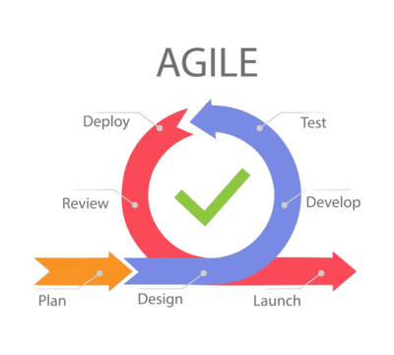
The Agile Software Development Lifecycle (SDLC)
The Agile methodology can be applied in many different ways
It is a flexible process framework, not a rigid set of rules
Agile allows teams to adapt while making continuous progress
Uses careful re-assessment and guided execution
Let’s explore an example of an agile process setup . . .
Graphic from pngtree.com

Slide 9
Planning
Design
Planning: The initial project phase
Starting project goals/needs are defined
Gather information like initial budget, timeline and team positions (like Scrum jobs) if applicable
*In later iterations this phase may be skipped or blended into Design
Design:
Define an MVP and/or list of deliverables
Assess any potential roadblocks
Assign tasks to members and begin the Development
This phase will be the starting point of each successive iteration
1
2

Slide 10
Development
Testing
Development:
Developers construct the feature(s) outlined in the overview
Follow industry best practices
Developers keep open communication with the whole team to track progress and issues
Testing:
The product is rigorously tested
Check for intended functions
Check unintended bugs or edge cases
Testers must think outside the box to cover all action cases and tailor common test cases to the product and user
3
4

Slide 11
Deployment
Review
Review:
The product, deployment and User/Stakeholder/Market response are tracked
Iteration success and delays are analyzed by the team
Ideas for next Iteration are collected and condensed
Review is necessary to eliminate errors in the process, and reinforce strategies that were successful
Deployment:
Agile team assesses deployment feasibility
Like Development, uses User Stories to guide decisions
Deployment can be just as tricky as Development, and requires knowing the markets and platforms that need to be served
5
6

Slide 12

Launch
Launching a product is also a form of iteration.
The product should be in a stable state which meets all (or at least most) of the User Stories and Stakeholder needs
The launch of a product is a crucial point in the life cycle
User expectations may be higher
Future development can continue, re-following the Agile cycle to iterate further
Graphic from Wikipedia.org

Slide 13
Waterfall Method

Slide 14
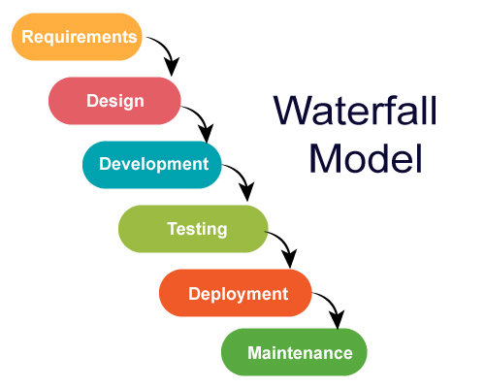
The Waterfall SDLC
Is not iterative
Only assesses requirements once
Development phase never affects Design phase
Design is executed without adjusting for new needs or obstacles
Testing has a smaller effect on Development
Deployment is final, and only followed by Maintenance
Graphic from medium.com

Slide 15
Agile vs. Waterfall
Allows teams to adapt to changes in requirements and roadblocks
Uses feedback cycles during development
Best for large projects or those with loosely defined requirements or that are likely to change
Best for large teams or complex products
Pinpoints requirements from the start
Feedback occurs only after deployment
Useful for projects with strict requirements or small scopes
May pair well with a ‘big bang’ style of development or in small teams
Can be used in a more iterative, Agile-like manner
AGILE
WATERFALL

Slide 16
References
Agile Development Process Infographic, Agileanaly, Sisanaly, Development PNG and Vector with Transparent
Background for Free Download. (2021). Pngtree.
https://pngtree.com/freepng/agile-development-process-infographic_8737029.html
Cobb, C. G. (2023). The project manager’s guide to mastering agile : principles and practices for
an adaptive approach.
https://ebookcentral.proquest.com/lib/think/reader.action?docID=1895876&ppg=131
Digital.ai. (2023). 15th Annual State Of Agile Report. Https://Digital.ai/.
https://digital.ai/resource-center/analyst-reports/state-of-agile-report/
Jayathilaka, C. (2020, July 30). Waterfall vs. Agile Methodology. Medium.
https://medium.com/@chathmini96/waterfall-vs-agile-methodology-28001a9ca487

Slide 17
References cont.
Laoyan, S. (25, February 2). What is agile methodology? (A beginner’s guide). Asana.
https://asana.com/resources/agile-methodology
Scrum Guides. (n.d.). Scrumguides.org. https://scrumguides.org/scrumguide.html20

